Slide 1
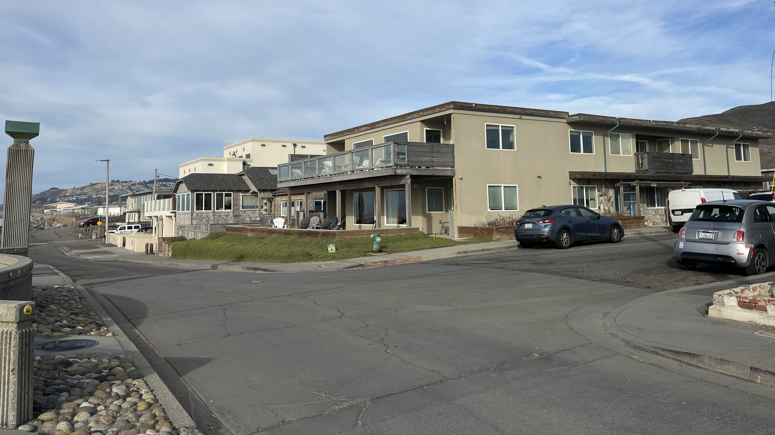
Sharp Park PDA Pedestrian Improvements Project
Resident & Property Owner Meeting
December 12, 2023, 6:00 PM – 8:00 PM

Slide 2
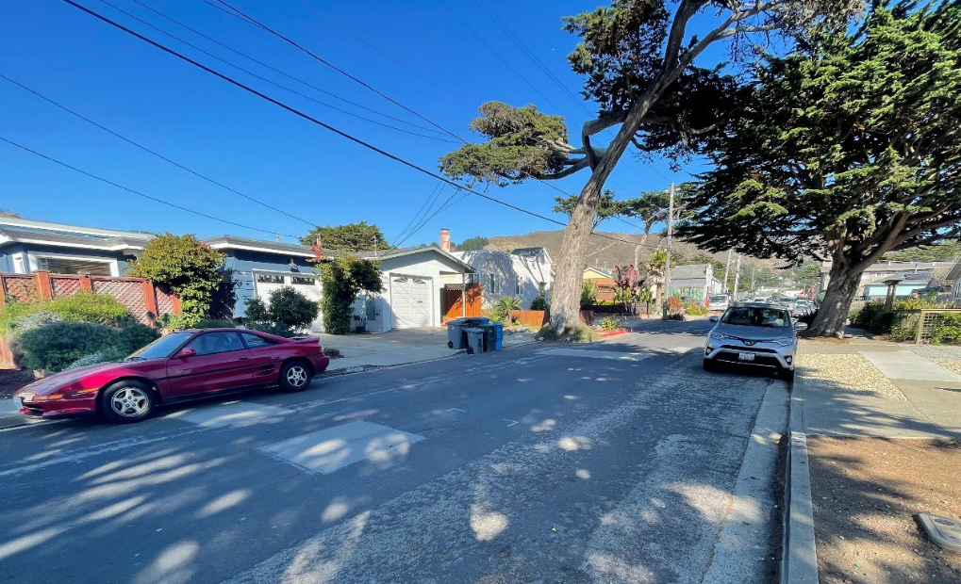
Agenda
Welcome and Introductions
Project Purpose
Project Scope
Project Schedule
Driveway Alternates
Q&A
Workshop – Review by block
Wrap Up
Adjourn
2

Slide 3
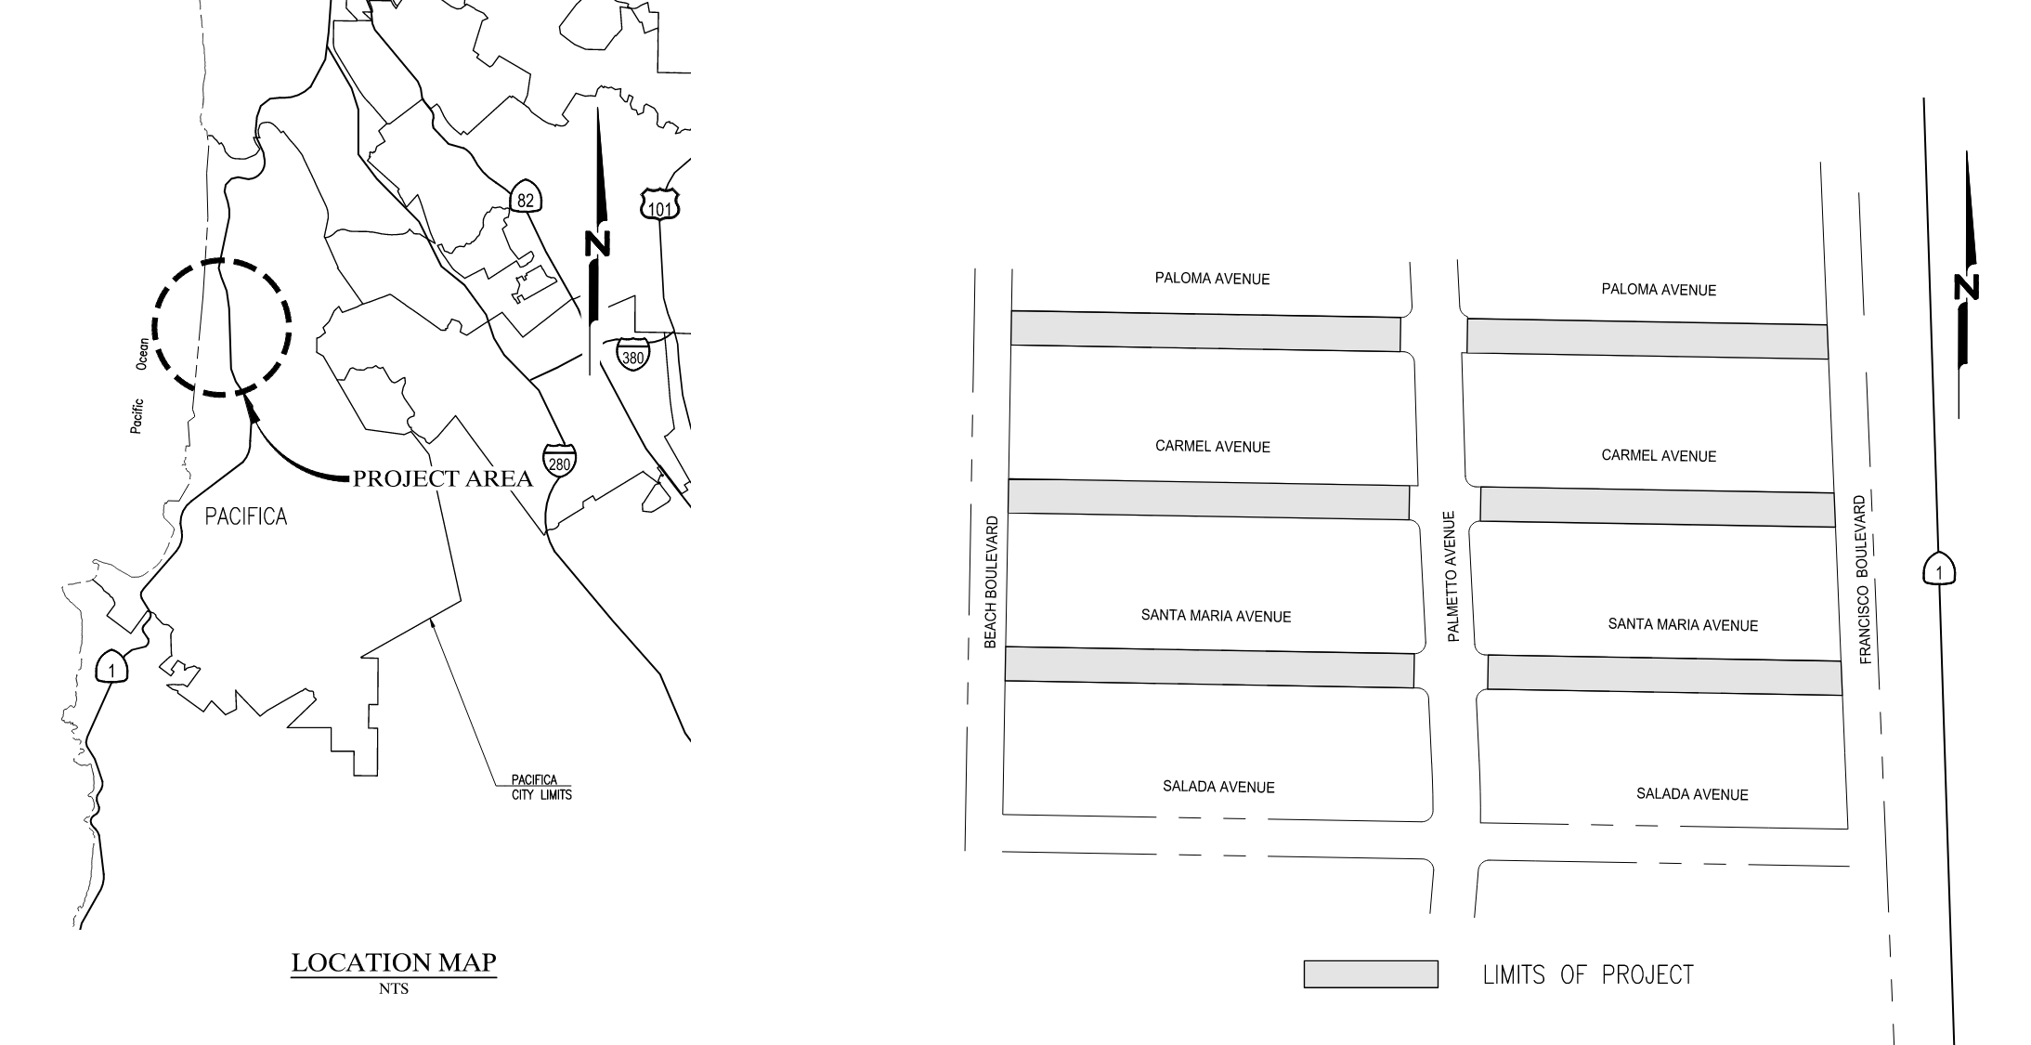
Project Area Map
3

Slide 4
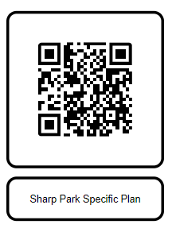
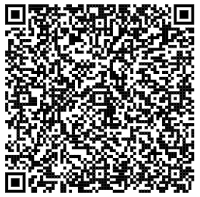
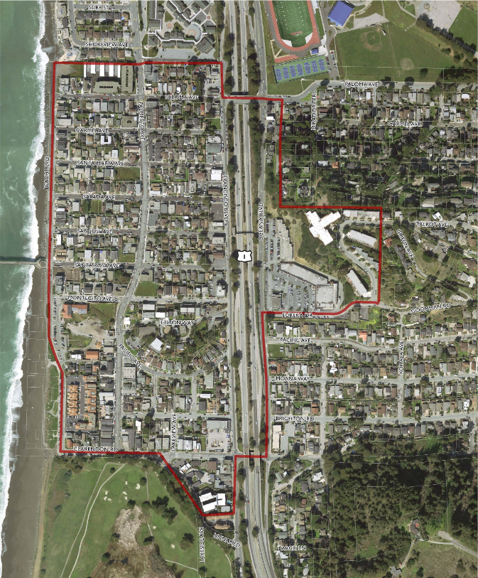
Project Overview
Project Purpose and Goals
Sharp Park Specific Plan
Priority Development Area (PDA)
Americans with Disabilities (ADA) standards
Provide a vital link for pedestrians and bicyclists
Provide enhanced and safe pedestrian & bicycle facilities
Sharp Park Project Site

Slide 5
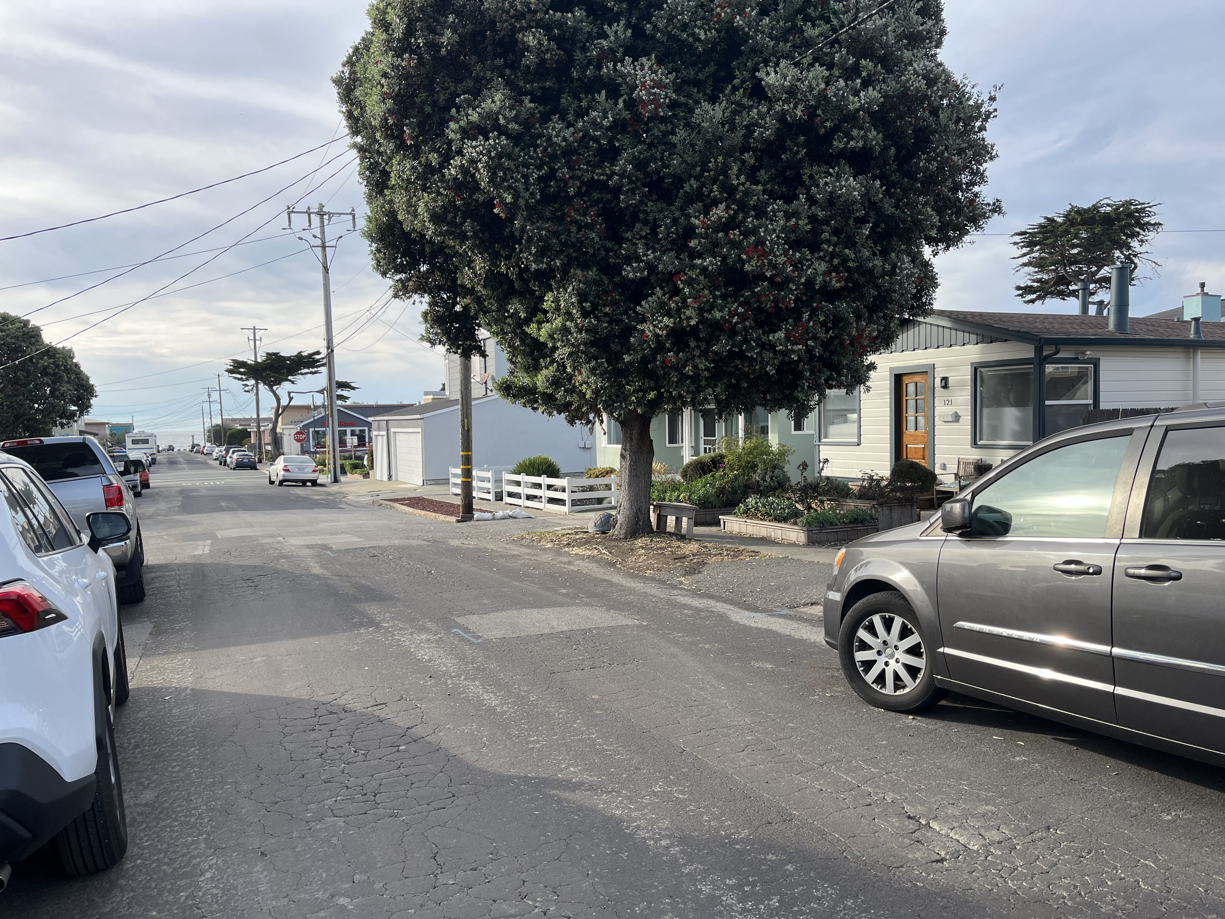
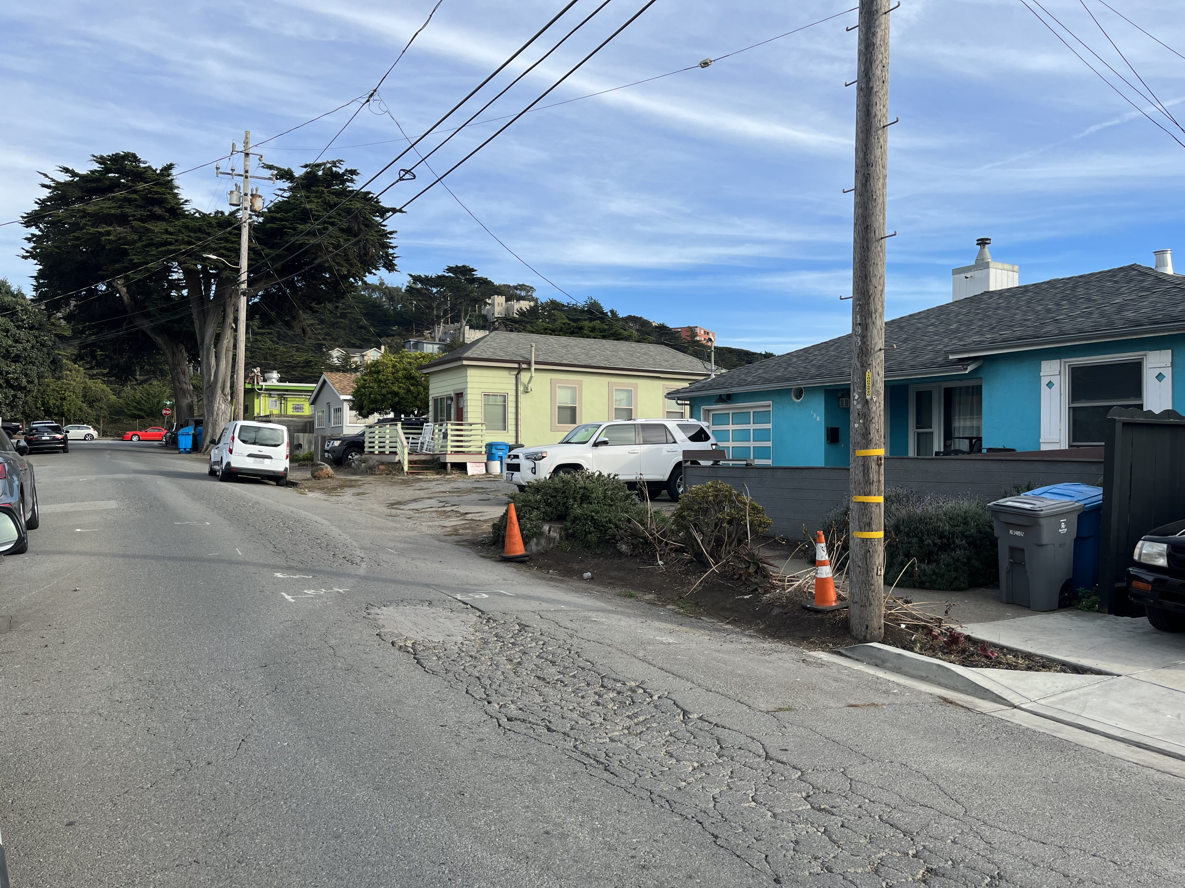
Project Scope
Improve sidewalk to ADA standards
Install ADA compliant driveways
Install ADA compliant curb ramps
Install curb & gutter to improve storm water management
Pavement spot repairs & microsurfacing
Install bicycle boulevard markings (Paloma Ave)
Improve crosswalk (Paloma & Francisco)

Slide 6
Project Schedule
90% Design Complete
Dec 2023
OBAG Funds Obligated
Jan 2024
Begin Construction
June 2024
Ready to Advertise
Mar 2024
Award
Contract
May 2024
Project Complete
Sep 2024
Preconstruction Meeting
May 2024

Slide 7
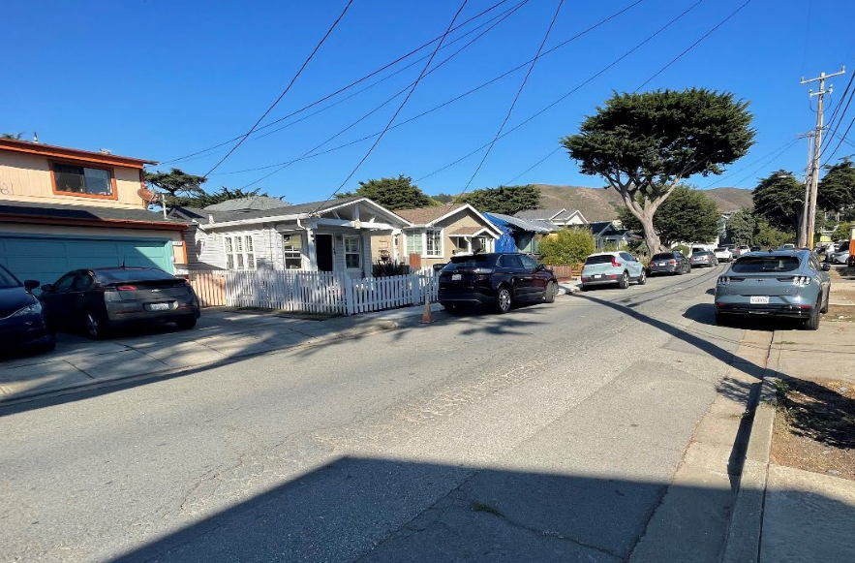
Driveway Designs
D
Each driveway is unique
Designs have been determined
Federal & Grant Requirements
Designed to fit ADA standards

Slide 8
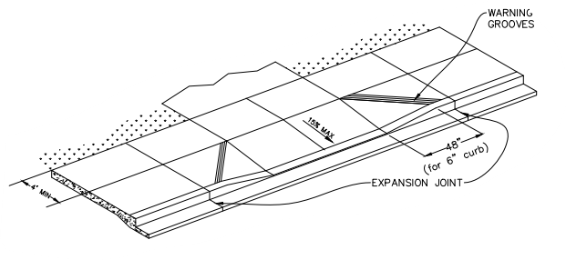
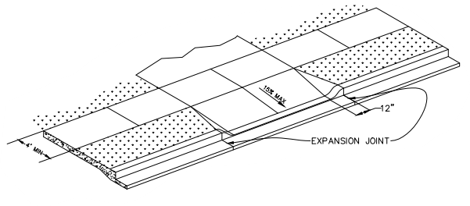
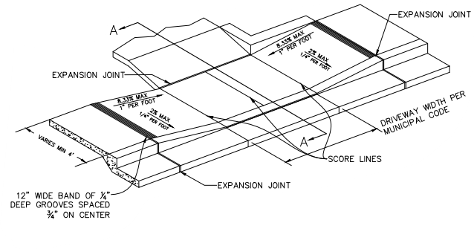
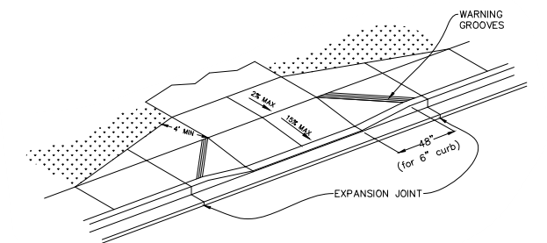
Driveway Designs
A: Standard Driveway
B: Standard Driveway with Landscaping
D
C: Depressed/Lowered Driveway
D: Tapered Driveway with Landscaping

Slide 9
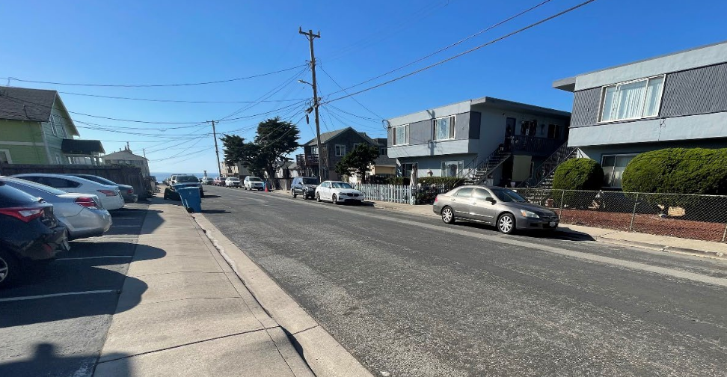
How Can YOU Help?
D
Please be prepared to move anything in the City’s Right-of-Way
Attend future pre-construction meeting with the contractor
Keep an eye out for future notices

Slide 10
We Want To Hear From You
Input?
Comments?
Questions?
(Please Proceed to the Interactive Stations)

Slide 11
THANK YOU!
Project Website
Project Manager: Bryan Bautista, Assistant Civil Engineer
Email: bbautista@pacifica.gov
Phone: (650)738-3769

